Slide 1


2Market Customer Insights & Marketing strategy
Enhancing Decision-Making through Analytics
Saadia Adnan
Notes:
Good afternoon, everyone.
Today, we are going to look at data-driven analysis of 2Market’s customers, spending behaviours, and advertising performance. Our goal is to grasp how analytics can improve decision-making and guide us with a more effective marketing strategy.

Slide 2
Business problem & strategic objective
Limited understanding of customer demographics
Unclear advertising channel effectiveness
Need for targeted marketing & optimal spend
Objective: enable evidence-based decisions.
Notes:
2Market currently struggles to understand who its customers truly are and which marketing channels deliver value. The data is available, but insights have not yet been fully extracted. This project identifies who our customers are, what they spend money on, and which advertising channels are worth investing in.

Slide 3
IDEAL - PROBLEM Solving FRAMEWORK
IDENTIFY
Need to understand customers
Need to evaluate advertising channels
Objective: support data‑driven decisions
DEFINE
Review customer + advertising datasets
Identify key fields
Plan tools: Excel, SQL, Tableau
EXPLORE
Clean data in Excel
Join datasets using SQL
Run queries on exposure & spending
Build initial Tableau visuals
LOOK BACK
Evaluate results & limitations
Identify improvements
Confirm strategic value of insights
ACT
Create full dashboards
Analyse demographics, spending & ad performance
Identify effective channels
Generate recommendations
Notes:
I applied the IDEAL problem-solving model because it provides a clear structure for analytical work. We identify the business problem, define the data structure, explore using SQL, Excel, and Tableau, act by building dashboards and insights, and finally evaluate limitations and future improvements

Slide 4
Data Preparation & SQL Process
Cutomer Data + Advertising Data
Joined Dataset (using customer ID)
SQL Queries on Advertising Exposure and Spending
Identification of Effective Platforms
Visual diagram of SQL flow
Notes:
Key points:
Cleaned income, removed duplicates, calculated age.
SQL LEFT JOIN combined customer + ad data.
Aggregate spending and exposure by demographics.
Using Excel and SQL, I prepared a clean unified dataset that joined customer demographics, spending behaviour, and advertising channel exposure. This enabled accurate segmentation and channel analysis.

Slide 5
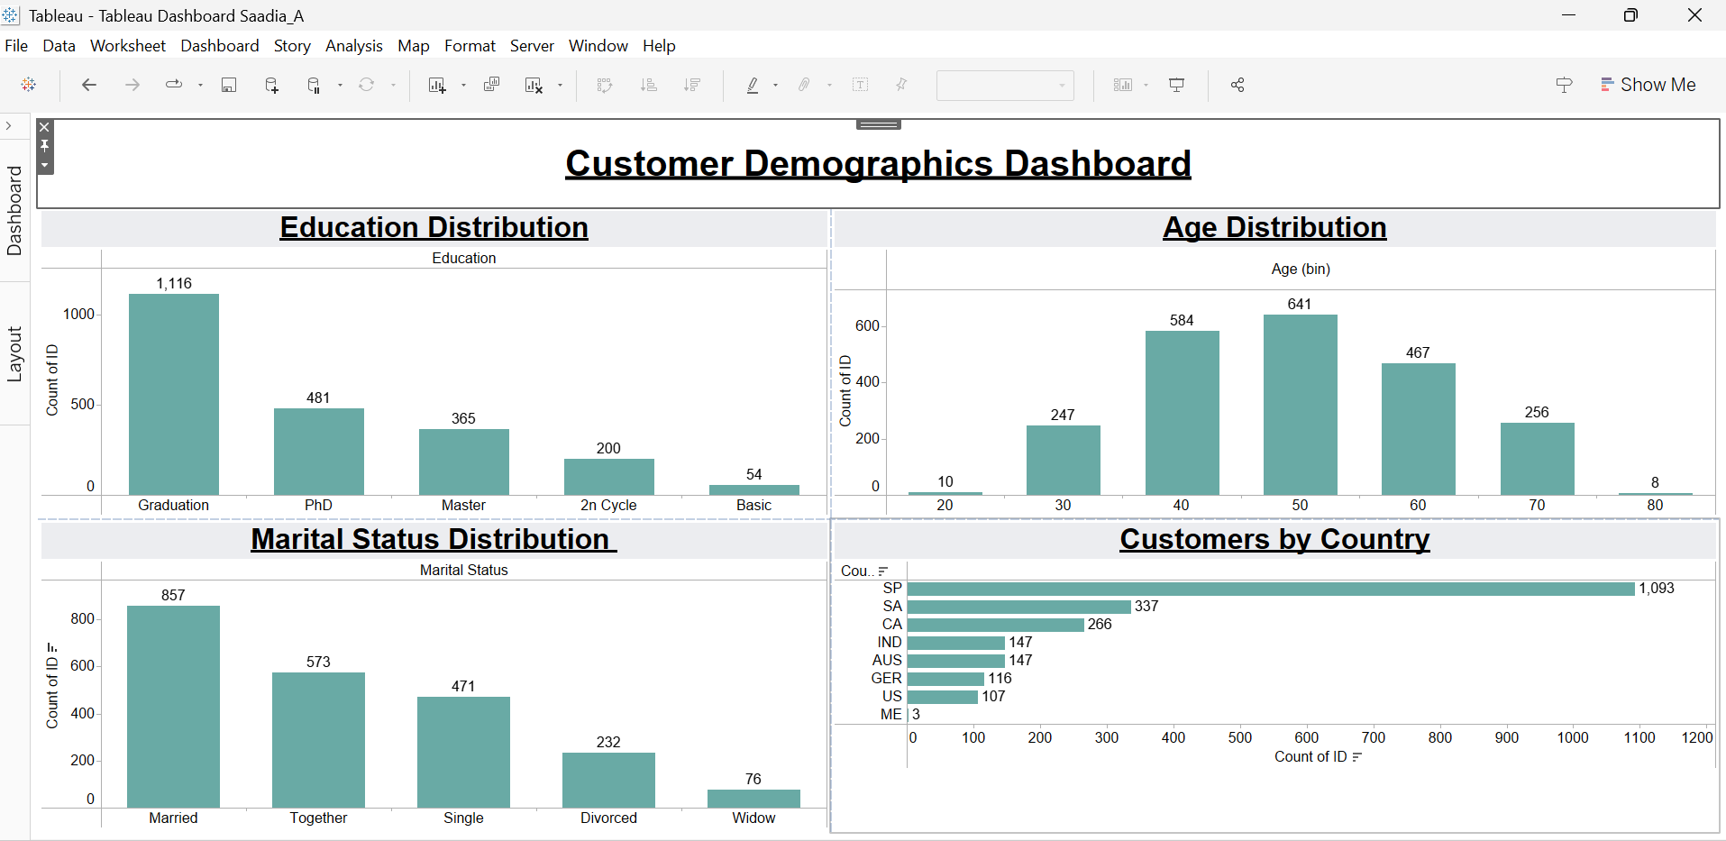
CUSTOMER DEMOGRAPHICS
Notes:
Average Age: 44
Age peak: 40-60 years
Education: Graduation = largest group
Country: Spain dominates
Marital Status: Married majority
These Tableau visualisations help us understand the demographic profile of 2Market’s customers.
First, the age distribution shows that most customers fall between 40 and 60 years old, with an average age of 44, indicating a predominantly middle-aged customer base.
The education chart reveals that the majority of customers have completed Graduation degrees, followed by Master’s and PhD levels. This shows that 2Market attracts a relatively educated audience.
Marital status insights show that Married customers make up the largest portion of the customer base.
Finally, the country breakdown highlights that Spain is by far the largest customer segment, with substantial contributions from SA and CA.
Together, these visuals give us a strong foundation for understanding customer behaviour and designing targeted marketing strategies.

Slide 6
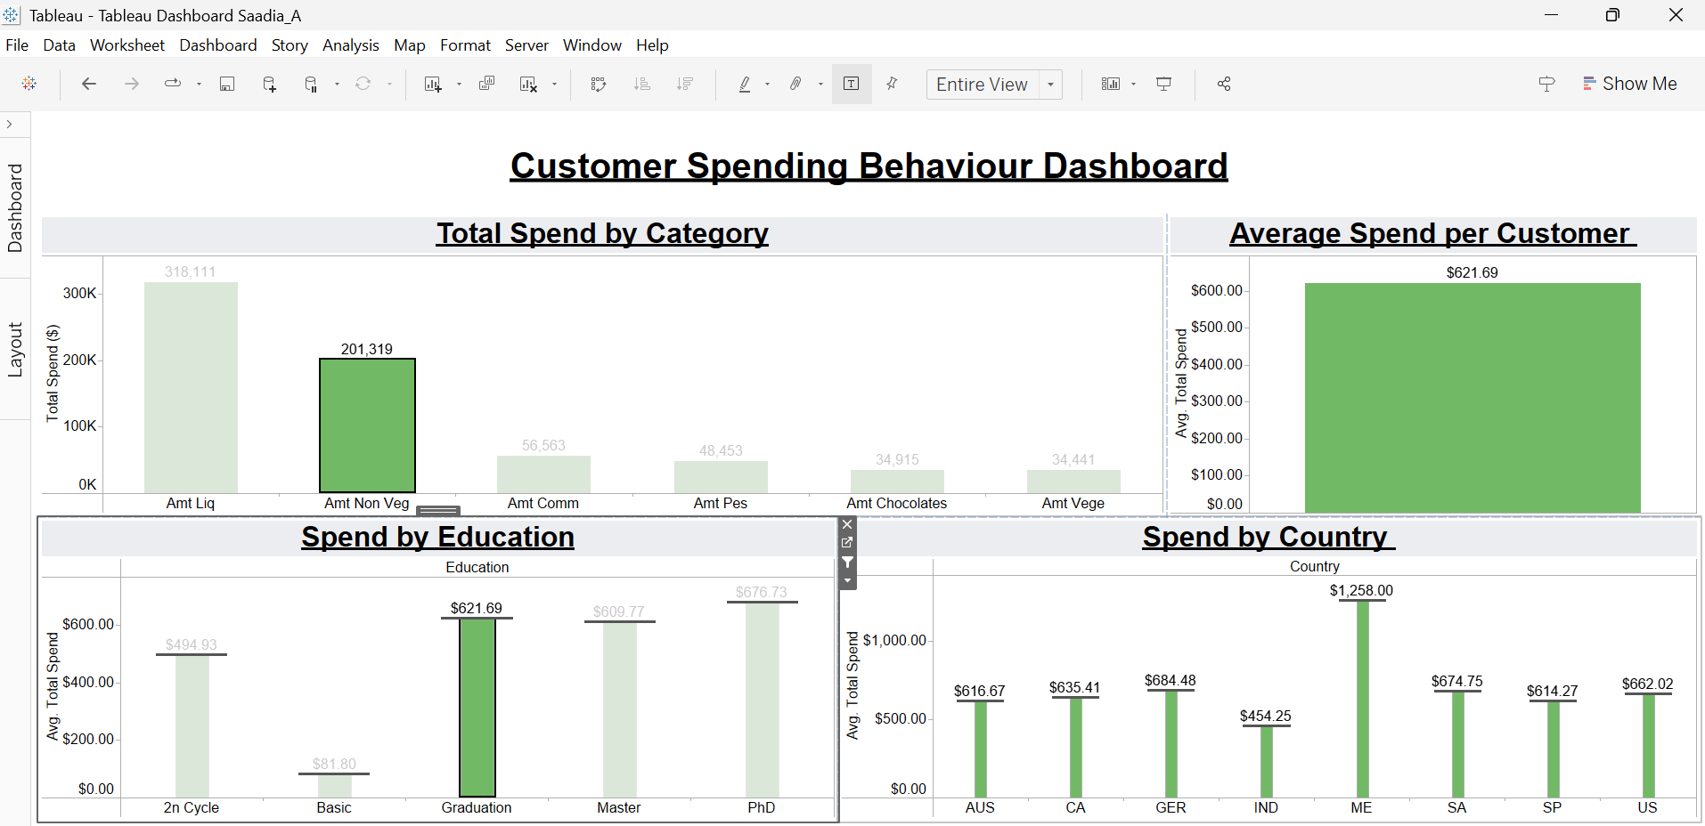
Notes:
Spending increases significantly with age, with customers aged 60+ spending the most. High‑income and highly educated segments also show higher average spend. Product spending is dominated by alcohol and non‑vegetarian categories, highlighting profitable segments.

Slide 7
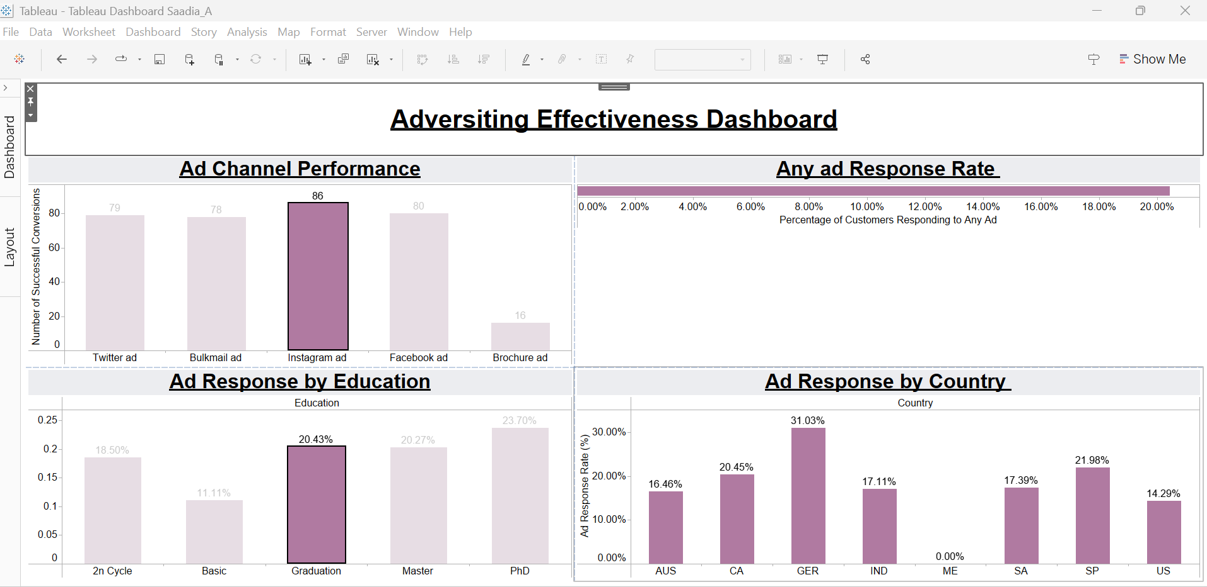
Notes:
Digital channels clearly outperform print. Twitter, Bulkmail, Instagram, and Facebook generate high exposure, while brochures perform poorly. Overall, 20% of customers respond to ads, but response varies by country and education — showing potential for more personalised campaigns.

Slide 8
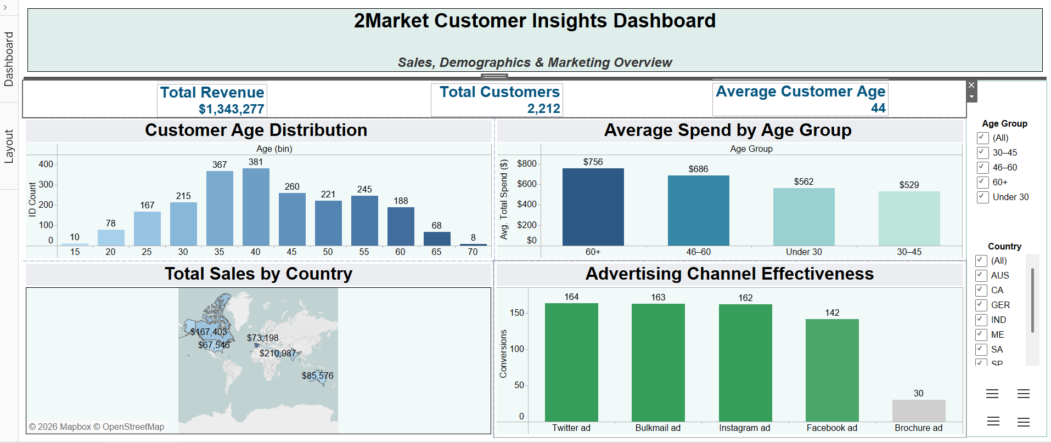
Notes:
Here you can see the full customer insights dashboard I created in Tableau. At the top, the KPI cards summarise our key metrics: total revenue of 1.34 million, a customer base of 2,212 and an average customer age of 44.
The visuals on this dashboard provide a consolidated overview of the three core analytical areas: demographics, spending behaviour and advertising effectiveness.
On the left, the age distribution confirms that most customers fall between 40 and 60. The second chart shows how spending increases with age, particularly for customers aged 60 and above.
The map highlights that Spain is our biggest customer segment, with strong contributions from South America and Canada.
Finally, the advertising performance panel clearly illustrates that digital channels—especially Twitter, Bulkmail and Instagram—outperform brochures by a large margin.
This dashboard allows 2Market to explore customer behaviour interactively using filters, making it a powerful tool for strategic decision-making

Slide 9
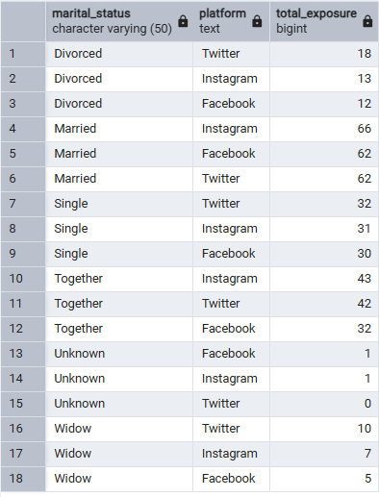
Platform effectiveness per marital status
Notes:
Married customers have the highest exposure, followed by Together and Single groups. Divorced and Widowed segments show lower engagement, and Unknown is almost zero. This tells us which groups our digital campaigns reach most effectively.

Slide 10
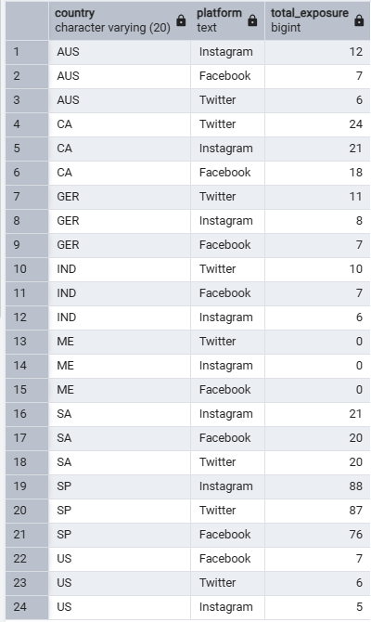
Platform effectiveness per country
Notes:
Spain shows the strongest exposure across all platforms. South America and Canada perform moderately well. Exposure is much lower in AUS, IND, GER and US, and the Middle East has no reach. This highlights where our digital marketing is most effective.

Slide 11
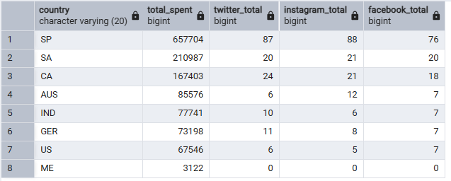
Platform performance vs spending per country
Notes:
Spain generates the highest spending, clearly matching its high platform exposure. South America and Canada also show good spending and engagement. Countries with low exposure, like AUS, IND and the US, also have lower spending. This shows a strong link between digital reach and customer spending.

Slide 12
Insight summary
Married, Together & Single = highest reachable groups Spain, SA & CA = strongest digital markets Digital exposure aligns with higher spending Low‑exposure regions (AUS, IND, US, ME) need a different approach
Notes:
These insights show who we reach best, which regions respond strongest, and how exposure links directly to spending. This helps shape where marketing investment should go

Slide 13
Strategic implications
Prioritise high‑exposure regions Strengthen digital investment Tailor campaigns for top marital segments Review strategy for low‑reach markets
Notes:
Based on the patterns, we should increase investment in markets with strong reach, tailor messages to high‑engagement groups, and rethink our strategy in low‑reach countries.

Slide 14
Recommendations
Increase digital ad budget (Twitter, Instagram, Facebook) Reduce brochures (very low performance) Personalise campaigns by marital status & country Improve visibility in AUS, IND, US & ME Use A/B testing to optimise campaigns
Notes:
These actions improve efficiency, reduce waste, and ensure campaigns are better aligned with customer behaviour across different regions and groups.

Slide 15
Conclusion
Data → Insight → Smarter decisions Target key segments Invest where impact is greatest
Notes:
In conclusion, data‑driven insights give 2Market a clear roadmap for smarter marketing decisions, stronger customer engagement, and better return on investment

Slide 16
Q & A
Thank you
Any Questions?

